Slide 1
Using the Global CX Calculator as a Sales Tool
May 17, 2022
Arle Lommel & Hélène Pielmeier
Copyright © 2022 by CSA Research
Notes:
Doesn’t cater to your typical clientele. Will focus on clients when selling abroad. So we still want to present this to you so you can use it as you expand your focus. At least some hospitals are treating it as a customer experience and providing at least minimal translation of websites.

Slide 2
Agenda
Swiss Cheese and Global CX
The Global CX Calculator
Demo Time
Using the Calculator with Clients and Prospects
Questions

Slide 3

Swiss Cheese and Global CX

Slide 4
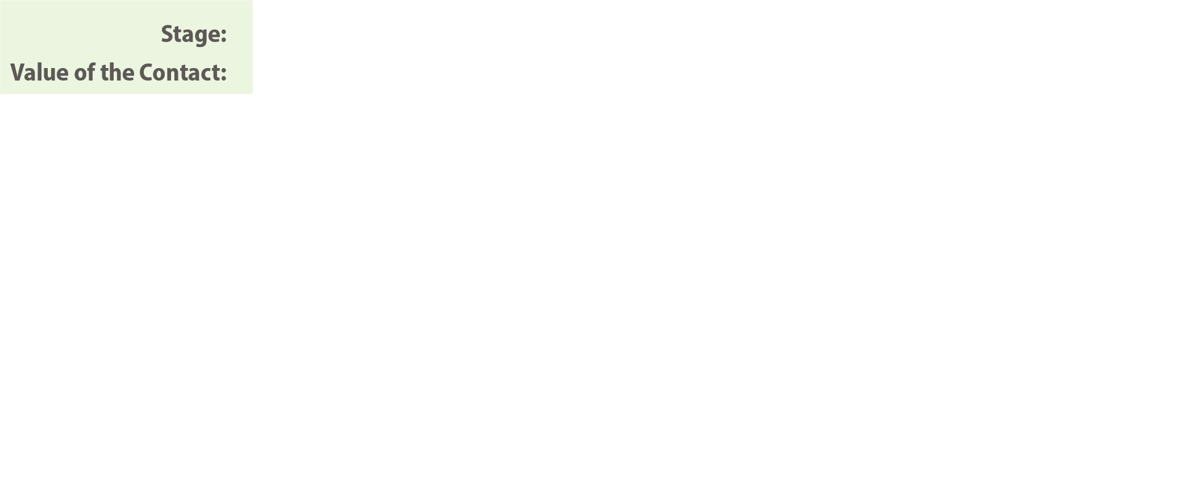
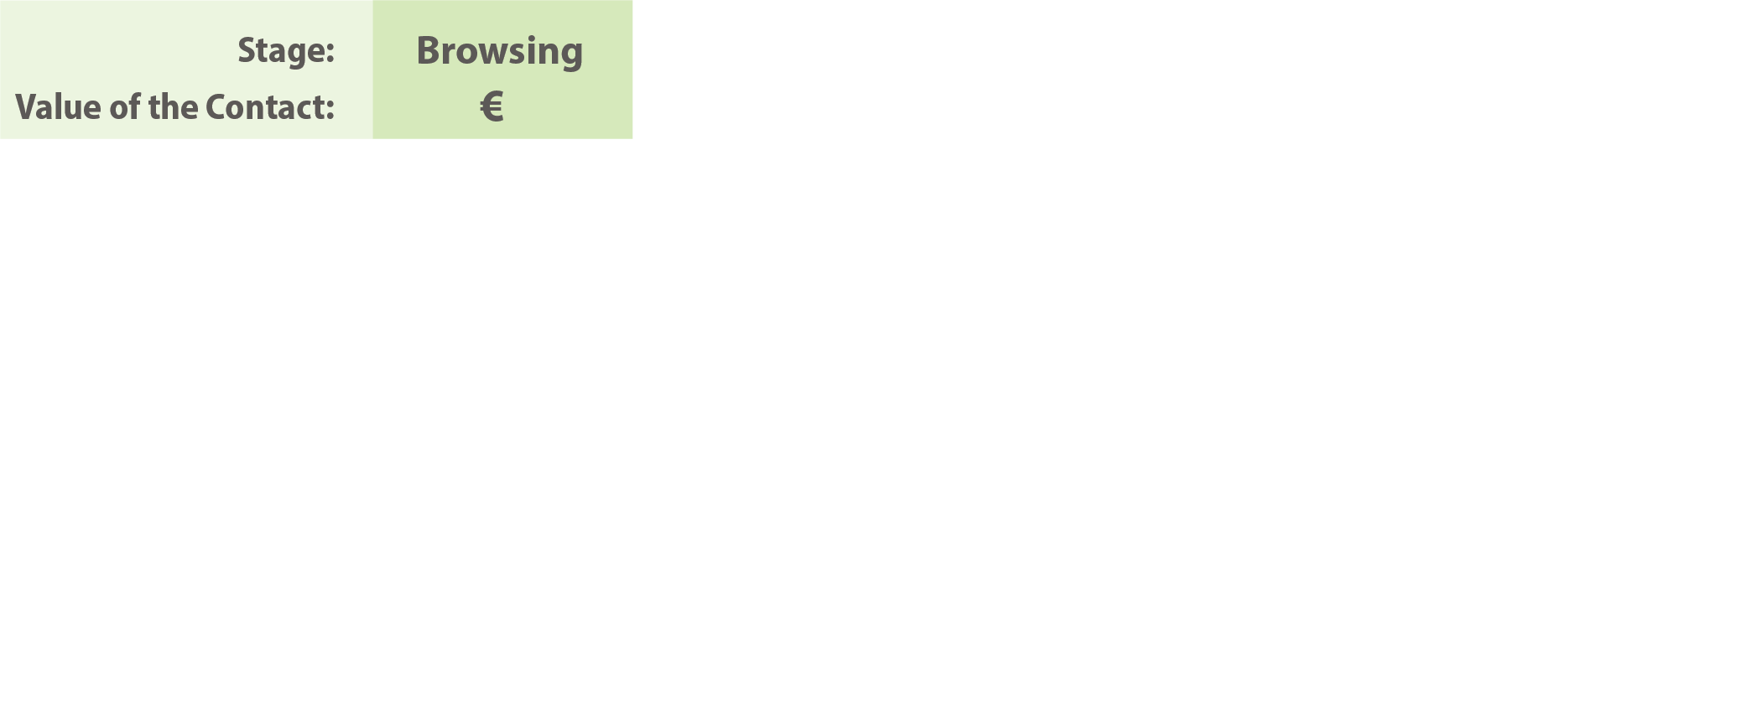
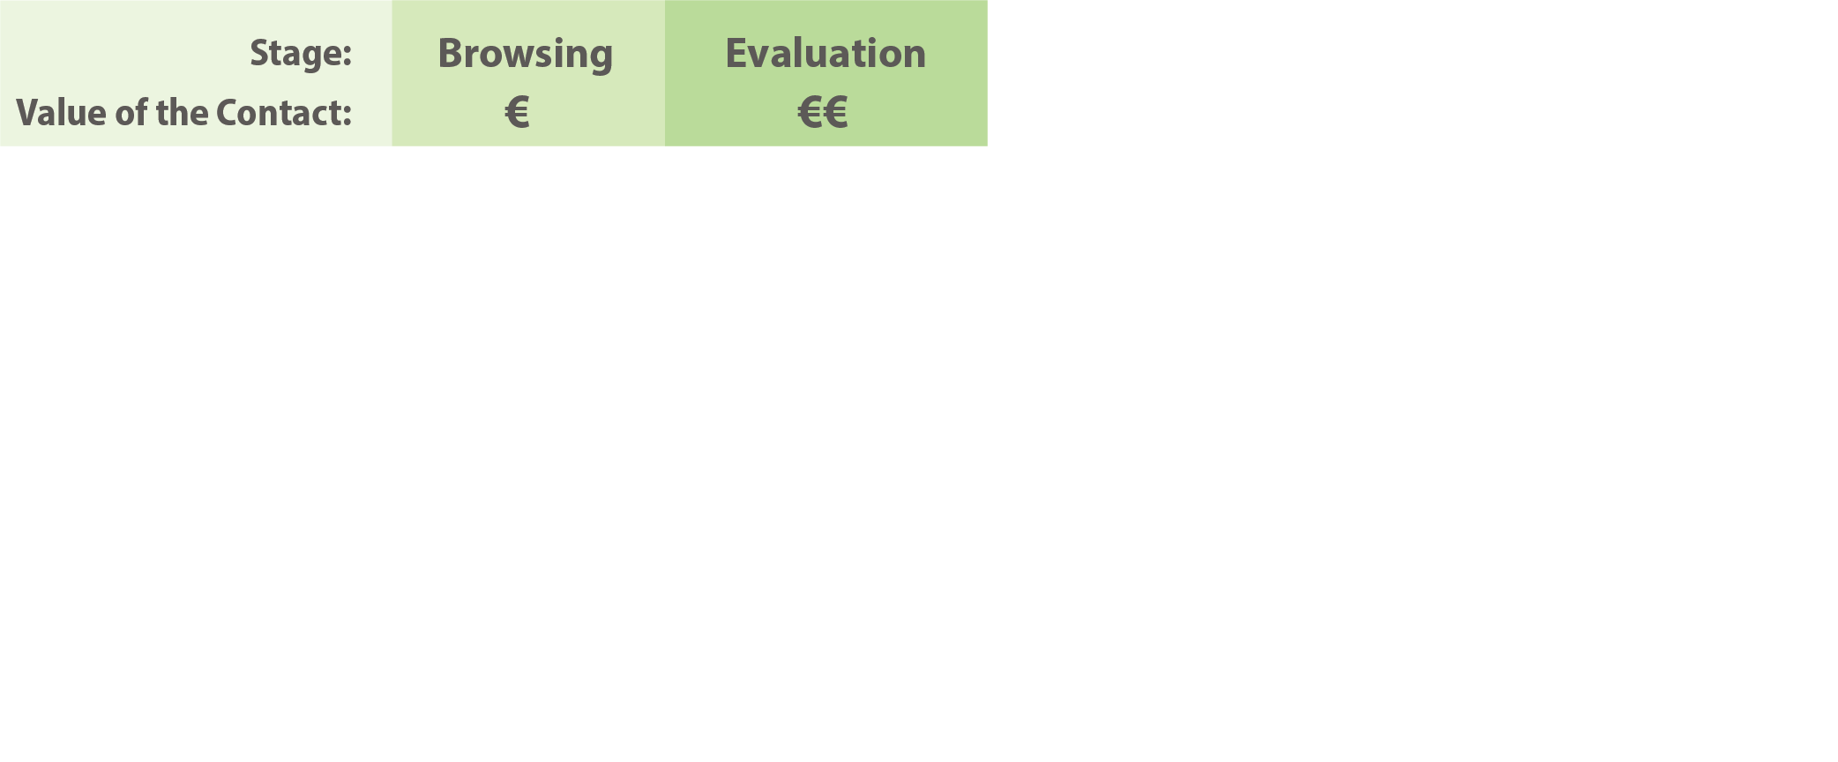
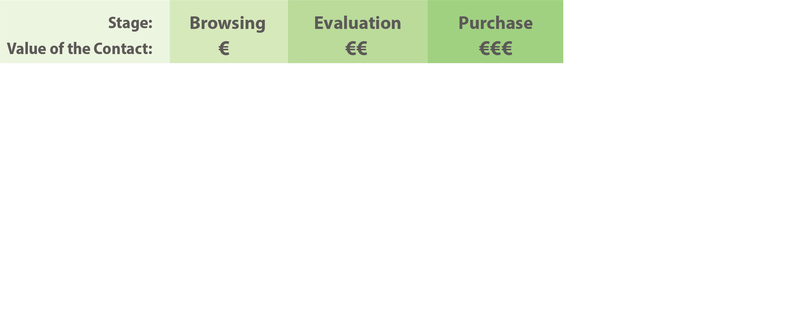
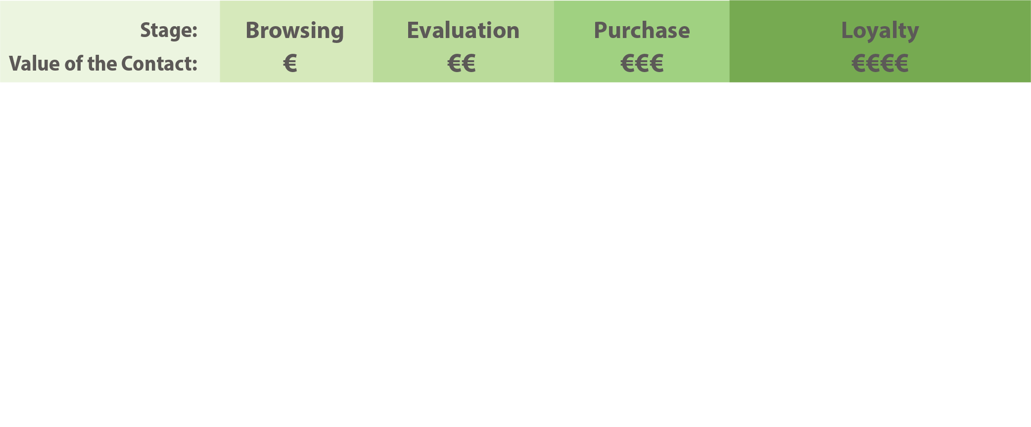
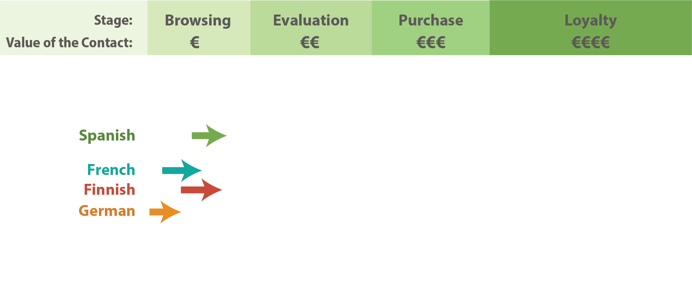
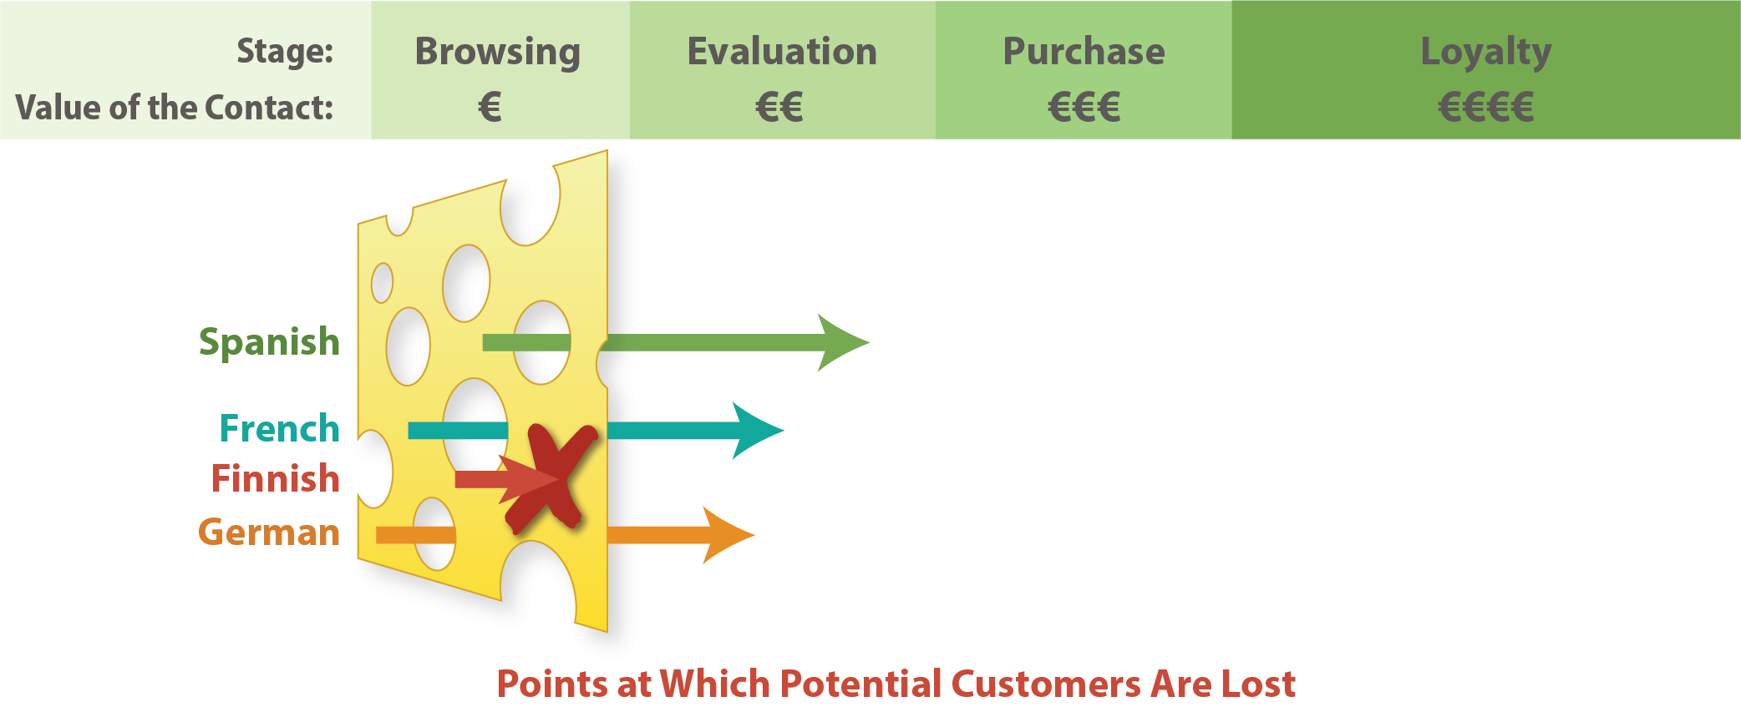
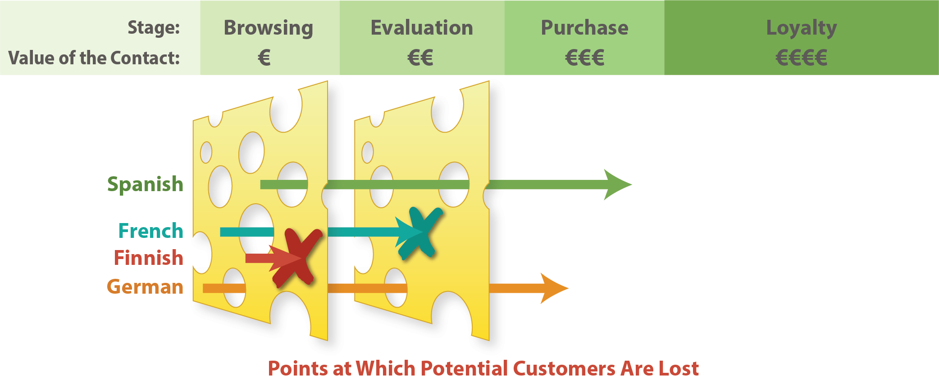
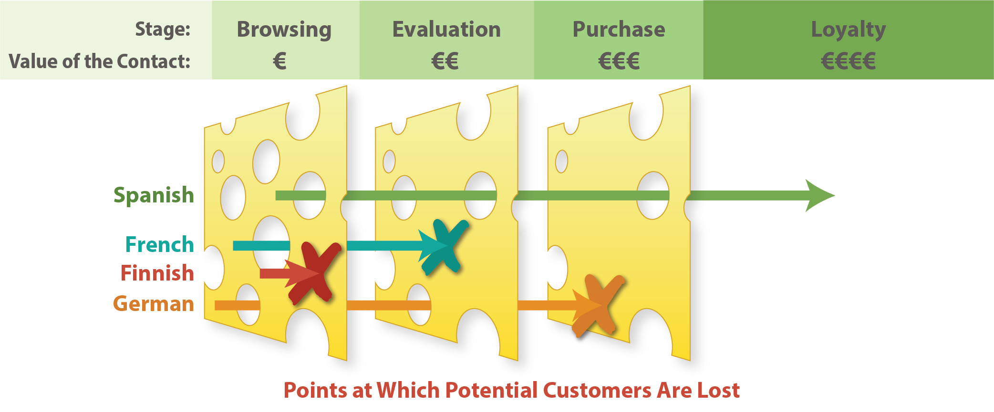
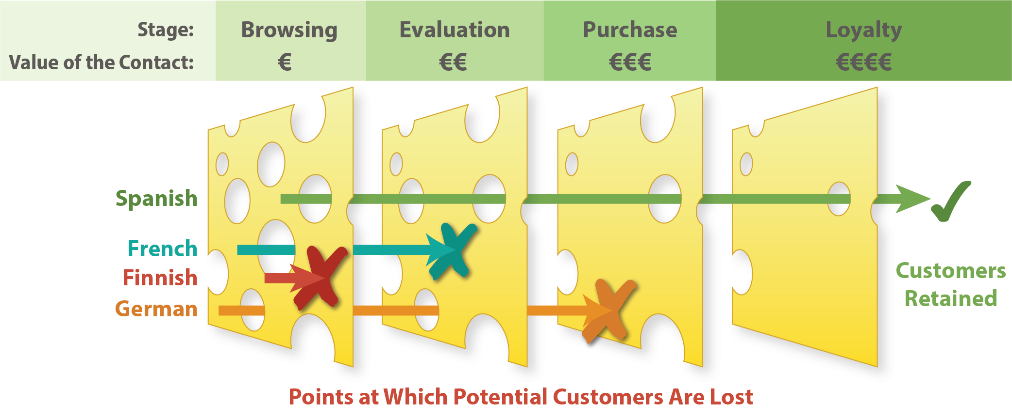
The “reverse Swiss cheese model”
Notes:
To set the stage, I want to start with what CSA Research calls the “reverse Swiss cheese model” for customer interactions. This is based on Dr. Reason’s famous Swiss cheese model, a tool for for disaster prevention in which organizations set up multiple layers to prevent accidents and other problems. These layers are depicted as slices of Swiss cheese, with the idea that if there is a hole in one layer that would allow a disaster to occur, it should be prevented by other layers (which themselves might have holes in other areas). In our model, we turn this concept around.
To understand it, let's start by thinking about the typical experience of visitors to international sites and break their interaction into four simple phases.
<CLICK>In the browsing phase, visitors have no real intention to buy yet, but are curious and want to see what is there. At this stage, the site needs little more than localized navigation and top-level pages. The purpose is to engage interest. At this point, the average value of an individual visitor is quite low: Many will leave after a few seconds or will determine that the site isn’t what they are looking for.
<CLICK>The next stage is evaluation. Here the visitor has some interest and is looking for specific information to inform the purchase decision, such as product information, manuals, reviews, and other similar materials. Individuals at this stage are worth more on average because they are beginning to form purchase intent.
<CLICK>If all goes well, the purchase phase comes next. Here, the contact is looking for where to pay. The contact is thus quite valuable but needs to find a localized purchase experience and support for local payment options. Without this, the contact will turn to competitors.
<CLICK>Finally comes the loyalty phase where the contact has made a purchase but becomes a repeat purchaser, a subscriber, or a recommender. These individuals are the most valuable because they enter into a relationship with a brand and bring others along with them.
So let’s consider now how this plays out for the site of a US-based personal healthcare products company that provides varying degrees of localization for some European languages.
<CLICK>In particular, let’s start with four individuals who speak Spanish, French, Finnish, and German, and let’s assume they do not speak English. What happens when they encounter the site?
<CLICK>In this example the Spanish, French, and German speakers find a localized site with navigation and some basic marketing information, and this slice of cheese lets them through. But the poor Finnish speaker finds an impenetrable wall of English, and goes elsewhere.
<CLICK>Next, we find that the French site really had only marketing information, but no other content, and so the French speaker hits a wall of English cheese and drops out while the Spanish and German speakers are able to evaluate the products and decide to purchase from the site.
<CLICK>At the purchase stage, the German speaker does not find a localized purchase experience because the company assumes all Germans speak English, so even though she would like to purchase some items, she is confused and abandons her shopping cart. Note that this is the first point where lack of localization leads to the loss of actual purchase intent. However, there is a hole for the Spanish speaker to pass through: A localized purchase experience lets him buy what he was looking for.
<CLICK>Finally, we reach the phase where loyalty is built and when the Spanish speaker comes to find support for his product he is lucky and finds that information about it has been translated, even though much of the site with after-sales support and information has not. In this case he goes on to recommend the product to others and becomes a repeat customer.

Slide 5

Implications of this model
“Almost” doesn’t get you there
Failure at any single point can result in the customer walking away
Enterprises need to factor in the entire journey
Many invest the most in phases with the least value per visitor
Notes:
So let's think about the implications of this model.
<CLICK>First, in the customer journey, it doesn’t matter if someone almost made it to purchase or almost made it to becoming a loyal customer. From the perspective of the enterprise, the customer journey is ruthless, and
<CLICK>It only takes one mistake, a failure at a single point, for customers to walk away to a competitor that offers their language.
<CLICK>As a result, enterprises need to factor in the entire journey. Despite this, our research has shown that the typical enterprise localizes just 5% of its website content. Some languages typically benefit from a considerably higher localization rate – particularly for sites translating into English – but many others receive less. In fact, it is not uncommon for even large enterprises to support languages with just a localized homepage or just the highest-level marketing pages.
<CLICK>What this means is that enterprises often invest the most in those areas of the site that deliver the least direct value per visitor but ignore the ones that lead directly to income. Admittedly, because of the reverse Swiss cheese model, they have to start with the navigation and marketing if the other content is to be effective, but far too many stop at that point and then wonder why their localization is not paying big dividends.

Slide 6
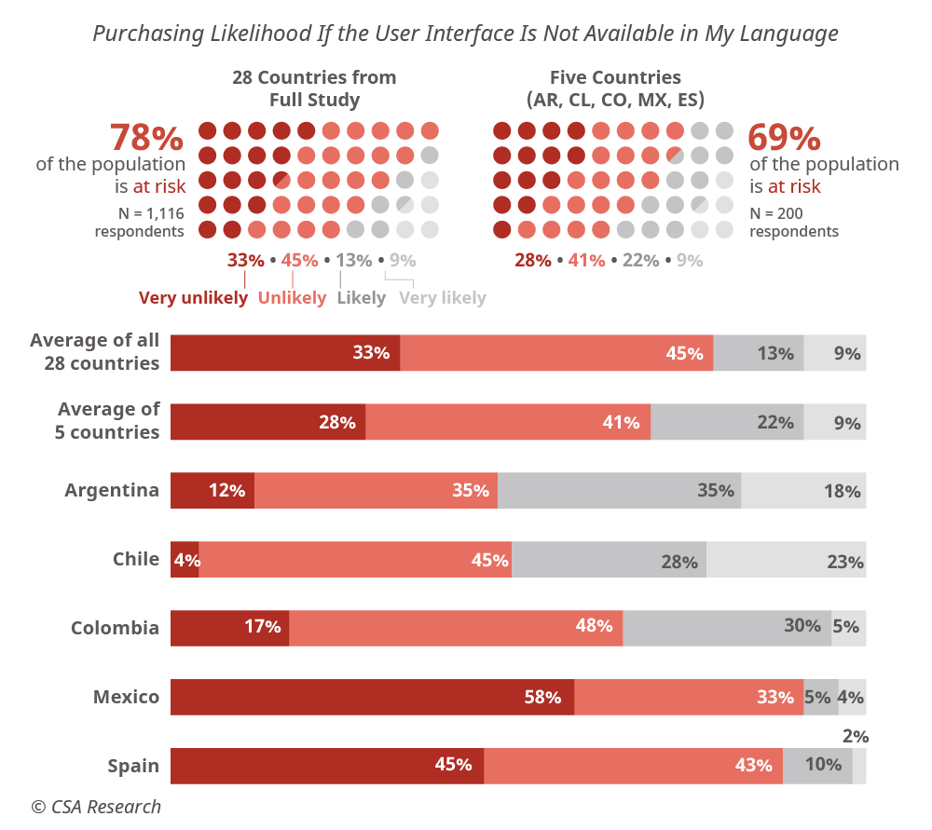
“Can’t Read, Won’t Buy” sets the stage
The series provides valuable insights into self-reported buying behavior of both B2C and B2B buyers
Data focuses on key decision points in the customer journey
Not easy to turn the results into predictions for how current localization is likely to affect customers
Three-quarters of online consumers are unlikely to purchase from sites that do not support their language!
Notes:
In order to address these factors and provide concrete guidance, our “Can’t Read, Won’t Buy” series has focused on gathering representative data from both B2B and B2C buyers about how localization – or the lack thereof – at various stages of the customer contributes to their likelihood to purchase or remain a customer. This data is expensive to collect if you do it right, but the insights make it worth it.
<CLICK>We organize the data along key decision points in the customer journey, emphasizing phases of the experience.
<CLICK>Although the results are valuable, it is not easy to turn them into actionable insights for particular sites or companies.
<CLICK>Nevertheless, the reports are full of key takeaways you can use in marketing and discussion with clients and prospects. For example, you can tell them that 75% of online customers are unlikely to purchase from sites that do not support their language, or that Germans are among the least likely to make purchases in other languages because they are used to having content in German. Having such facts from this research at hand can help you engage with clients and discuss their needs, but now we have a better tool to assist you with making concrete predictions.

Slide 7
The Global CX Calculator

Slide 8
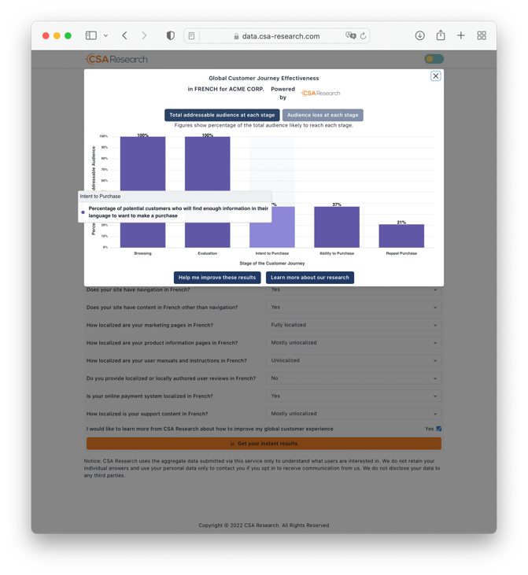
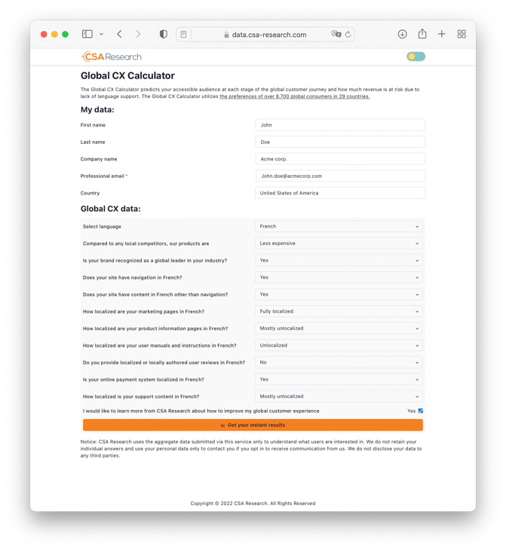
The Global CX Calculator: Predictive analytics for CX
The Global CX Calculator
Uses the insights from over 3,700 global consumers in 29 countries to predict how localization affects willingness to purchase
Uses 11 questions about localization levels to take the results and apply them to individuals in each market and predict how likely they are to make it through the customer journey
Notes:
This tool is called the Global CX Calculator.
<CLICK>It provides predictive analytics for discussing your clients’ customer journeys. It is based on over 37,000 global consumers in 29 countries, and we will be adding an additional 1,200 from four more countries soon.
<CLICK>The tool itself is simple to use: You answer 11 questions about what is – or is not – localized on a site, and how much is localized, and it then
<CLICK>provides predictions for what percentage of an audience of prospective customers is likely to reach one of five stages in the journey.
Let’s now take a look at those particular stages (which differ from the model I showed earlier) in more detail.

Slide 9
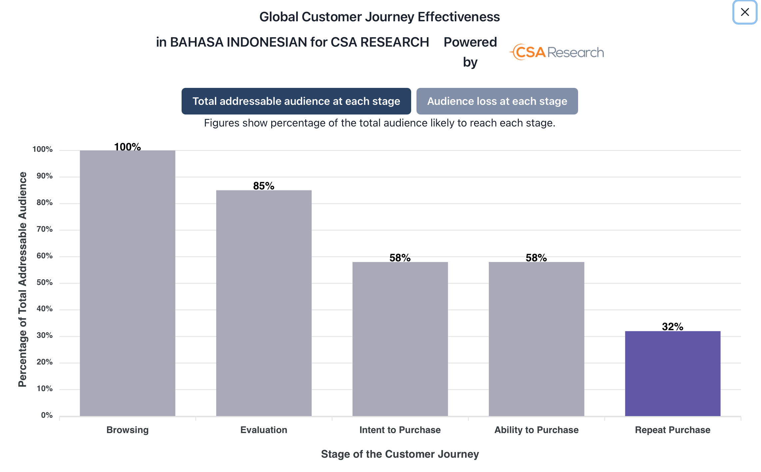
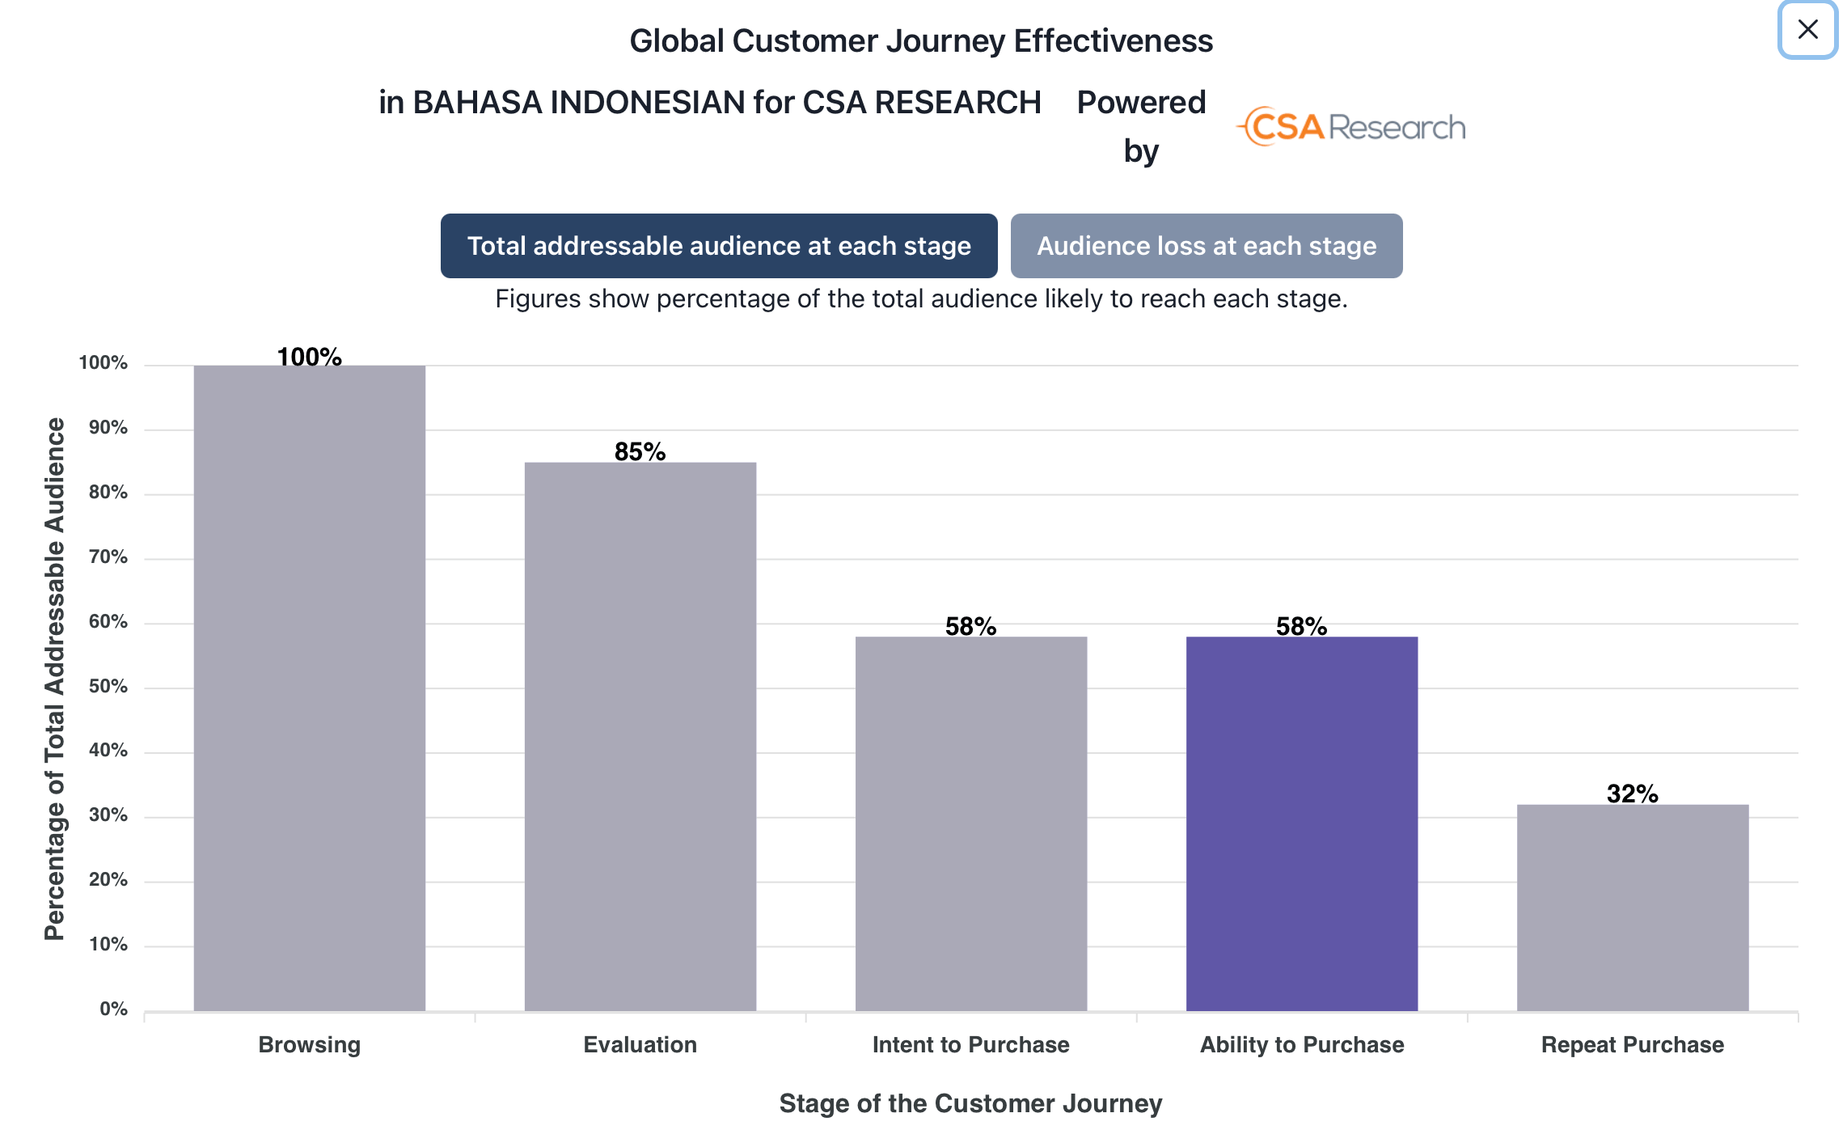
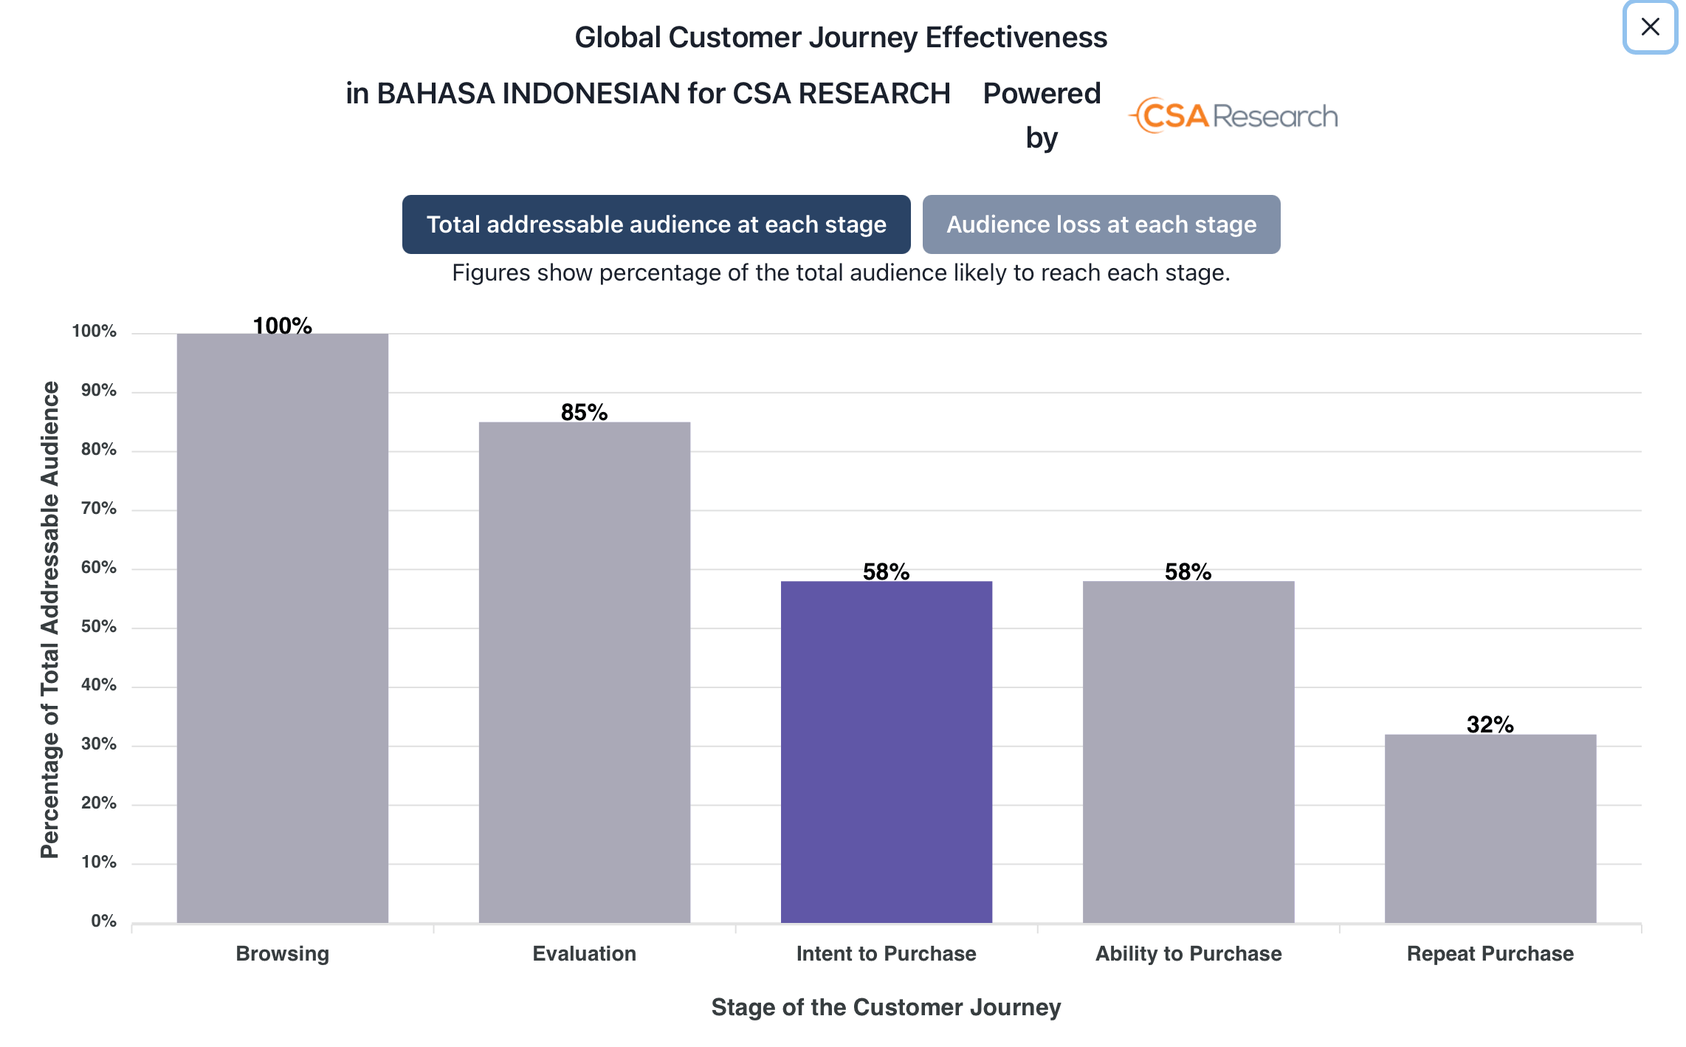
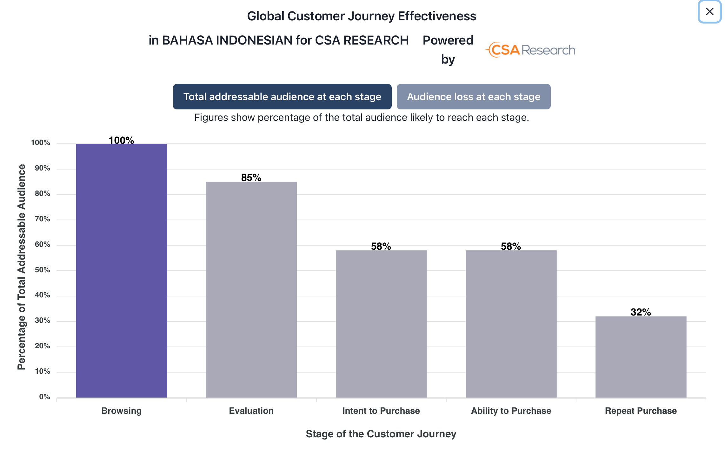
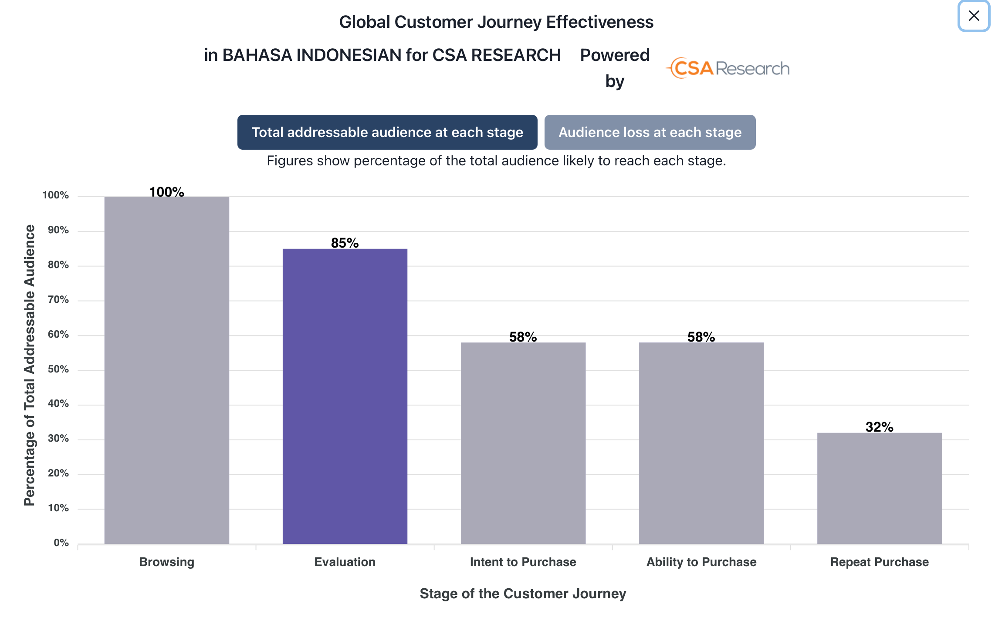
Introducing the Global CX Calculator
https://data.csa-research.com
Notes:
To help quantify how language support is likely to impact the effectiveness of a company’s global customer experience, we created a quantitative model based on the stated buying preferences of 300 online consumers per language who were asked about how the availability of in-language content affects their likelihood to purchase. This model calculates how far each survey respondent is likely to make it through a given customer experience based on their individual responses. We quantified this at five major milestones, although the underlying research quantifies several others. If you aren't addressing these points, others are unlikely to matter:
<click>1. The ability of potential customers to browse the site. Do they find navigation and other content such that they can use the site? Note that in our model, if a company hasn’t localized to support this, we don’t ask them any other questions because their customers will not find anything else. Here I should note that we do give a bonus to companies that are recognized global brands or have offerings cheaper than their competitors in a market: Some individuals prefer to purchase major brands even without localization or prefer cheaper options, even if it means they will miss their language. That said, this effects are relatively minor.
<click>2. The ability of customer to evaluate the site’s offerings. Can they find enough marketing information to investigate the site and begin evaluating its offerings? Here we factor in the marketing content that attracts visitors to products or services and encourages them to learn more. This is usually the first point of contact with a company before visitors know which offerings make sense for them.
<click>3. The intent to purchase. Will visitors find enough product- or service-specific detail to convince them that they want to purchase from the site and that the goods and services will meet their needs? This is the point when the site moves beyond general marketing to technical details, specifications, and other targeted tools that individuals consult to make the purchase decision. I should note here that we give a bonus here to companies that localize customer reviews: Our research shows that reviews can, to some extent, make up for missing first-party content on sites.
<click>4. The ability to purchase. Does the site support a localized purchase experience that meets customers’ needs or does it leave them with inappropriate and useless options? Many sites provide a good journey to this point, but then turn aside customers by not supporting their language, currency, addresses, or payment methods. It doesn’t matter if you want to make the purchase if you cannot ship something to your home or make a payment.
<click>5. Likelihood of repeat purchase. Does the site provide enough after-sales support to keep customers loyal and happy or does it leave them to their own devices with no assistance? Here we focus on support content in particular because many respondents in the surveys cited lack of support as a major reason why they will not make a repeat purchase.
This tool is currently available free of charge on the CSA Research website so that you can try these scenarios out yourself.

Slide 10
Demo Time
Notes:
With that as background, let's spend a little bit of time with the tool itself in a live demo. I'll ask one of you to think about one of your clients that you would like to see localize more content and we will go through the questions for one of their languages and see the results. Depending on time, we may do a couple of these.

Slide 11
Using the Calculator with Clients and Prospects
Notes:
Let's turn now to how you can use this tool to engage your clients and prospects.

Slide 12
Which functions understand the value of CX
Good targets
Marketing and sales
Strategic planners and investors
Executives (CEO, CFO, CMO)
Localization leads who are arguing for greater investment
Not worth the effort
Lower-level staff with no decision-making power
Technical leads
Procurement staff

Slide 13


#1: Marketing collateral
Did you know that…
Use the results from the Global CX Calculator to obtain figures for specific markets
Combine with other insights to create a compelling narrative of why prospects should invest in localization
95%
US$1.9 trillion
of Spanish speakers are unlikely to purchase from your brand if you do not provide any content in Spanish?
Source: CSA Research’s Global Customer Experience Calculator
is the value of Spanish in the United States, roughly equal to the global value of Dutch and Italian.
Source: “Big Opportunities in Domestic Language Needs” (CSA Research)
Notes:
TB: Discuss how this applies to offline purchases and engagement.
When Hélène did the marketing presentations, she told you to use data, and this is an example of where you can get it and how to use it.

Slide 14
Discussion: Where would you see the Global CX Calculator fitting in MasterWord’s marketing?
Notes:
Use this to move beyond price/quality, usual blah blah. Helps elevate the discussion.

Slide 15
Option #2: Proactive engagement with clients or prospects
Pick one or more client languages, or one you would like to sell to them
Run the Global CX Calculator for those languages and identify what the client could gain
Run a campaign that focuses on how localization can boost your client’s sales
To: Bill <bill@customer.com>
Re: How can you boost sales in French up to 170%
Dear Bill,
Did you know that you may be able to boost your sales to French-speaking customers by up to 170% when you improve your support for their language? Our analysis shows that you may be walking away from substantial revenue in key markets. If you'd like to learn more, let’s set up a call…
Notes:
The first option is what we are calling a proactive loss analysis. This is something you could do in a mailing to individual clients.
<click>First, you pick one or more languages that the client supports (or one that you would like to sell to them). You might try multiple ones to see which one gives the most dramatic results.
<click>Next, run the calculator to find facts and figures you can use in your sales pitches. It's always good to include a relevant data point that grabs attention.
<click>Send customized messages to your prospects and clients that reflect the Calculator’s insights in an attention-grabbing way, ideally one that emphasizes how much money the company could make through more translation.
<CLICK>For example, this message emphasizes that the prospect could boost sales in French by 170% through localization and would be suitable for a client or prospect that has some French content but that is not really engaged with the language.

Slide 16
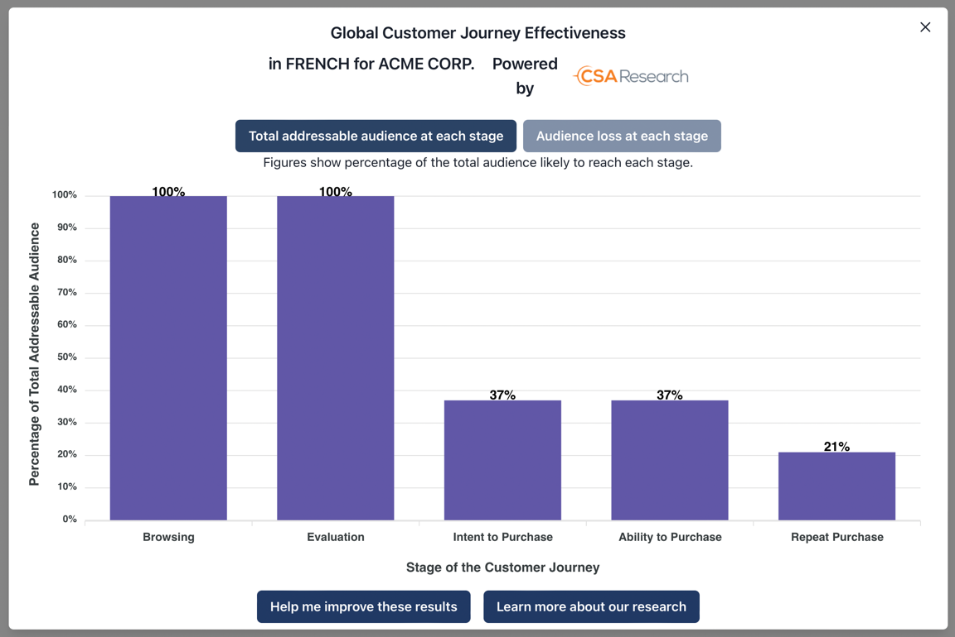
Example of an actual application
Limited localization leads to just 37% of potential customers making it through to purchase and just 21% becoming repeat customers.
(100%-37%)/37% = 170%
A 63% loss or a
173% increase?
Numbers help get your customers talking. Even if they think you’re wrong and want to tell you why, it opens the door.
Notes:
For example, I ran the Global CX Calculator with a site in French that has fully localized marketing materials but limited product information, a localized purchase experience, and moderate levels of support in French. This view makes it clear that the real loss comes from lack of product information so it provides insights into what the company needs to localize.
This is the analysis I used for the email solicitation in the previous slide. Here 63% of visitors would not make it through to purchase, so we divide this by 37% to get a potential uplift of 170%. Obviously, the numbers you find for your clients would vary. This way gives a bigger number than losing 63% and is just as accurate. By focusing on what they gain, it helps keep you from seeming like you are blaming them.
<CLICK>And note that even if your clients think these numbers are wrong and that they are doing better than you predict, it gives you an opportunity to discuss why you got the numbers you did and where they could improve.

Slide 17
Option #3: Interactive engagement
Good for account managers to upsell where you are already consulting with customers
Do preliminary analysis for all current and potential languages so you have facts at hand
Use the tool live with them to see how changing localization leads to increases
Language | Level | Potential revenue gain
French | Moderate | +62%
German | Good | +9%
Spanish | Good | +8%
Chinese | Low | +156%
What happens if we increase
localization of product information
and translate the sales portal for Chinese?
Notes:
The third method is interactive engagement where you use the Calculator with existing clients.
<CLICK>This works best where your clients already see you as someone providing them with objective advice that benefits them. So it is best for upselling clients or helping your clients’ localization managers to make a pitch to their management for additional budget. It is not a good choice for clients you do not know well (unless they respond positively to one of the previous methods).
<CLICK>The key to making this work is that you do a preliminary analysis so you have facts in hand when you start the conversation. For example,
<CLICK>in this simply example, you have already examined the client’s site (or leveraged your knowledge of it) and calculated that two of the language versions, German and Spanish, are in good shape and would offer minimal uplift through additional localization, but French has significant potential and Chinese, which has minimal localization, would benefit considerably. Having these numbers in hand in advance will help you be seen as an expert, particularly if you can tell your clients about where they are doing well as well as where they need help.
<CLICK>You then set up a time to use the tool live with them to explore how changes would help them. One hint is that you may want to have multiple browser tabs with the Calculator open in them for the different languages you want to show. This will save you the time it takes to enter data in the call, and then you can bring up a tab and tweak it in real time.
<CLICK>When you discuss the results with your clients or prospects, have set questions in mind, such as the one shown on screen. This will help you focus the discussion on concrete courses of action that you would recommend.

Slide 18
A few final notes
Use this to start the conversation and move to a deeper level
Emphasize possible outcomes
Remind customers that they need appealing products and content
Time to revenue is difficult to predict
Build your data savviness
Notes:
And before we wrap up and move to questions, I do need to give a few notes.
<CLICK>First, do not promise that your clients will gain a specific number from additional localization. Instead emphasize possible or likely outcomes. You do this to prevent the impression of giving a guarantee. We do this because time to revenue is not instantaneous and depends on many factors. In keeping with the reverse Swiss cheese model, localization is about removing obstacles,
<CLICK>but you still have to be certain that your clients’ offerings appeal in the markets where they are being sold. As an example of where no amount of content localization would matter, imagine a US company selling firearms that wants to localize into German: Although the Global CX Calculator’s predictions might be accurate, they could not overcome the problem that the products cannot be sold in Germany and would not have much appeal in any event. Or, to take a less controversial subject, if your client is localizing games, no amount of translation is going to make a war game sell well in France, but localizing a farming game would, while in other markets the results would be the opposite.
<CLICK>Another complicating factor is that calculating time to revenue can be complex. Most of the companies we talk to do not share information about time to revenue with their staff, but in one case, we were given detailed financial information and found that the time to revenue was typically about two years but the growth rates varied by market. As a result, we can predict that the company could realize particular growth in revenue, but also state that this would not be overnight. These realities may temper enthusiasm from companies that expect to see ROI within a quarter or two.
<CLICK>All this means that you need to build your data chops. This might mean you need to appoint one person who becomes your data guru and who handles requests for supporting data. Or it might mean that you need your entire team to develop a data-first mentality. How you handle this depends on your sales structures and processes, but it is clear that you need to have in-house skills in working with data.

Slide 19
Be strategic, tactful, and realistic
Focus on a realistic opportunity that clients will gain: Help them see strategic opportunities
Understand results takes time
Help clients prioritize their efforts: This is fodder for brainstorming
Be selective in who you approach and what you suggest
Please cite CSA Research as the source of your data and seek approval for marketing mailers, website, etc.

Slide 20
Questions?

Slide 21

Thank you!
Arle Lommel
alommel@csa-research.com
+1.812.369.1153
Hélène Pielmeier
helene@csa-research.com
+1.978.275.0500 x809
RESEARCH
INSIGHTS
TWITTER
www.csa-research.com
www.csa-research.com/insights
@CSA_Research

